Slide 1

CSE 3521: Introduction to Artificial Intelligence
[These slides are partially adapted from the UC Berkeley. CS188 Intro to AI at UC Berkeley]

Slide 2
Course information
Course website:
https://shuaichenchang.github.io/teaching/cse3521_au22.html
(mainly for weekly schedule and reading update)
Instructor: Shuaichen Chang (chang.1692@osu.edu)
6th year PhD student at CSE department
Office: DL 580
Research: Natural Language Processing
TA: TBA

Slide 3
Course information
Lecture time: Monday, Wednesday, and Friday, 11:30 AM - 12:25 PM
Office hours: TBA
No office hour the first week
Vote: office hour time and format (zoom vs in-person)

Slide 4
Course information
Carmen Zoom:
For office hours
Piazza:
For discussion. More information to be announced.
Carmen/GitHub:
For announcement, posting course materials (slides), and homework submission
Carmen quizzes:
For quizzes, and/or exams

Slide 5
Grading and homework
Grading Policy
Guidelines
Homework & Labs – 40%
Quizzes & participation – 10%
Midterm – 25%
Final – 25%
I may redistribute the midterm and final exam percentage
Expect 4 homework assignments (including problem and programming sets)
Solutions involve derivations or proofs. Grading is based on correctness and clarity. Be concise and show your reasoning in a clear and precise way.
Homework completion and submissions are individual, but feel free to discuss. You must strictly follow the submission instructions.
NOT ALLOWED: ask or search solutions
No late days are accepted.

Slide 6
Tentative schedule
Homework (2 weeks each)
Exams
HW1: 9/7-9/21
HW2: 9/21-10/10
HW3: 10/19-11/7
HW4: 11/7-11/30
Midterm: 10/12
Final: 12/15, 10:00am-11:45am ET
Due is all at 23:59 ET

Slide 7
Tentative schedule
Linear algebra quizzes (Carmen)
Other quizzes (Carmen)
Due: 9/7
8 of them (AI_linear_algebra_n)
Each is 0.5 points
Multiple attempts; the LAST is counted
You may do each quiz first. If you find it difficult, you may review the corresponding slide deck in the Linear Algebra Review module.
Due will be on Monday
The quiz will be released on the Friday before
There will be at most 12 of them
Each is 0.5 point (within 10 mins of work)
Due is all at 23:59 ET

Slide 8
Policy
Academic integrity
(Re-)grading
Plagiarism and other unacceptable violations
Zero tolerance
Please study the related sections in the syllabus (pdf) on academic integrity.
Only factual errors will be corrected.
Request: one week within the release of your homework and exam grade
Format: TBA

Slide 9
Pre-requisites & what to expect?
Pre-requisites
CSE 2331 (Foundations 2) or 5331
Linear algebra: Math 2568, 2174, 4568, or 5520H
Statistics, probability: Stat 3201 or 3450 or 3460 or 3470 or 4201 or Math 4530 or 5530H
Suggested: MATH 3345 (Foundations of Higher Math)
reasonable degree of mathematical sophistication
knowledgeable of basic algorithm design techniques and data structures
Extensive math and programming related Homework
Linear algebra, probability, and (multivariate) calculus
Programming: Python 3
AI algorithms often difficult to debug
We strongly recommend that you start early.

Slide 10


Textbook
Not required, but for students who want to read more, we recommend
Warning: Not course textbooks, so our notation/presentation does not necessarily follow the book.
See Carmen for PDF links.
Russell & Norvig,
AI: A Modern Approach, 3rd Ed.
Bishop,
Pattern Recognition and Machine Learning

Slide 11
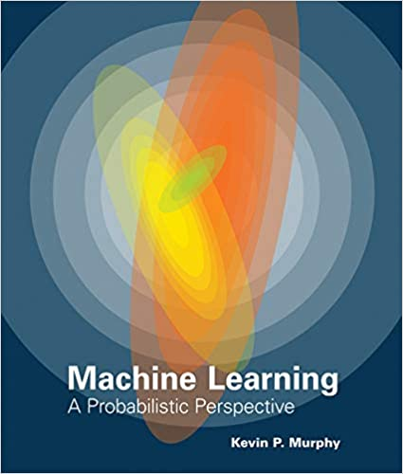
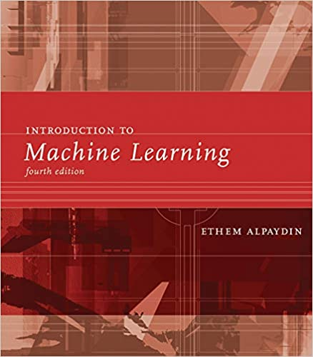
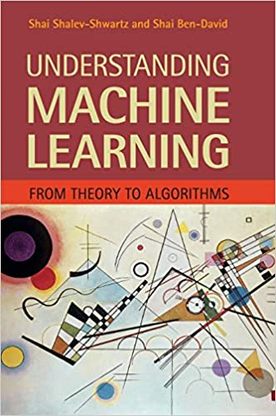

Other great textbooks
Machine Learning:
A Probabilistic Perspective
Introduction to Machine Learning
Understanding Machine Learning
Deep Learning

Slide 12
Other excellent resources
Berkeley CS 188: Introduction to Artificial Intelligence
https://inst.eecs.berkeley.edu/~cs188/su21/
The Matrix Cookbook

Slide 13
Important for this week
Register:
If you are wait-listed, you might or might not get in depending on how many students drop.
Math review/self-diagnostic:
Do the linear algebra quizzes and review linear algebra (via the slide decks)
Check the suggested materials on the website
Important to check your preparedness for the course
Python: check suggested tutorials on the website
Decision: stay or drop

Slide 14
How to do well? How to learn AI well?
Lecture and lecture slides for basics
Describe basic concepts, tools
Describe algorithms and their development with intuition and rigor
Textbook reading for extension
Homework for practice, generalization, and implementation
Discussion (Carmen/Piazza, office hours) for further understanding
Overall: Develop skills on grasping abstract concepts and thinking critically to solve problems with AI techniques

Slide 15
Questions?

Slide 16
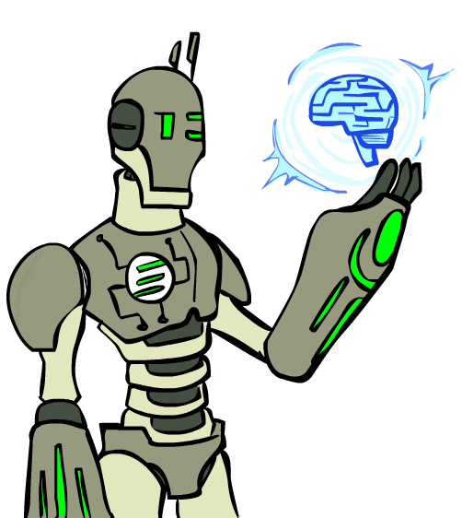
Today
Introduction
What is artificial intelligence?
What can AI do?
What is this course?
Agent design

Slide 17
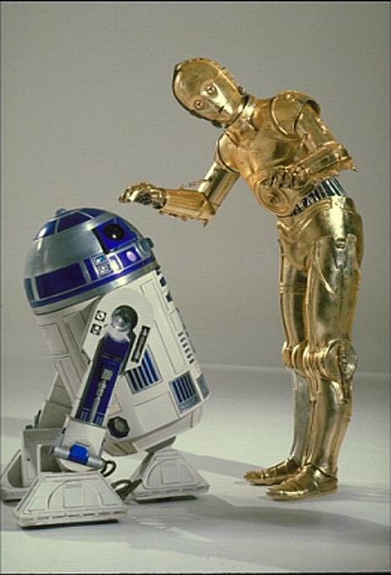

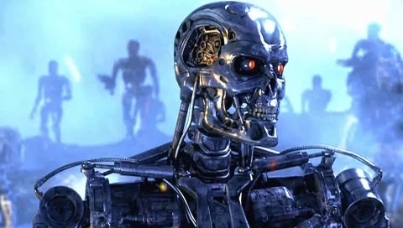

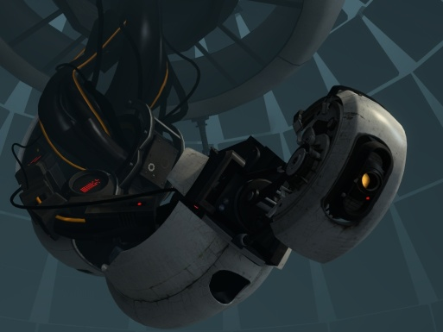
Sci-Fi AI?
Notes:
Who are these? C3PO, what does he do? Essentially Google translate (but with anxiety disorder!)
Small guy? R2D2 – what does he do, yeah, not so sure
Things got darker: machines come back from the future – to kill us!
90’s : software is scary
Basic fear about what technology might do?
What if we can’t even tell technology apart from ourselves?
or maybe it’ll look really different and snarky
Some exceptions like wall-E, positive view of technology (but maybe not of us humans!)
But mostly a worry
[not very worried myself, at least at present]

Slide 18
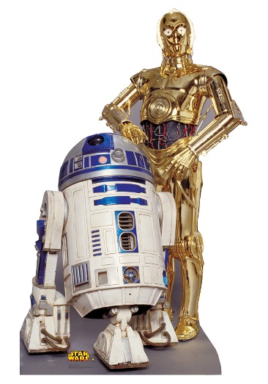
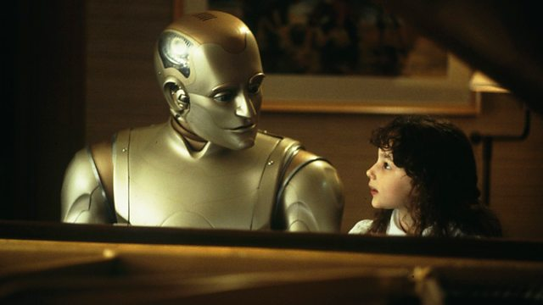

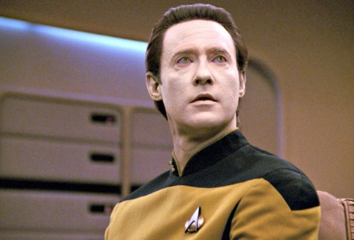
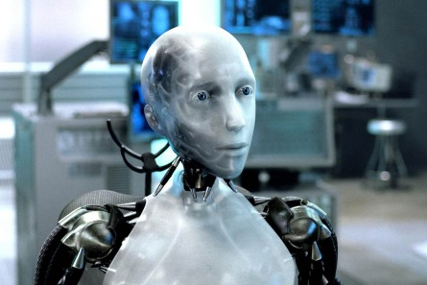
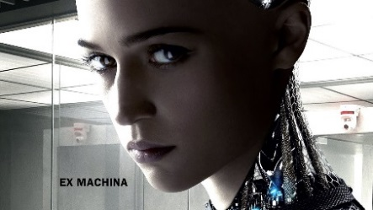
Sci-Fi AI?
Star War (1977)
Bicentennial Man (1999)
Iron Man (2008)
Star Trek (1994)
i, Robot (2004)
EX Machina (2015)

Slide 19
Some definitions of AI
“The scientific understanding of the mechanisms underlying thought and intelligent behavior and their embodiment in machines”
– American Association of Artificial Intelligence (AAAI)
“Artificial Intelligence is the branch of computer science that is concerned with the automation of intelligent behavior”
– Luger and Stubblefield
“AI strives to understand and build intelligent entities (also helps us to learn more about ourselves)”
– Russell and Norvig

Slide 20
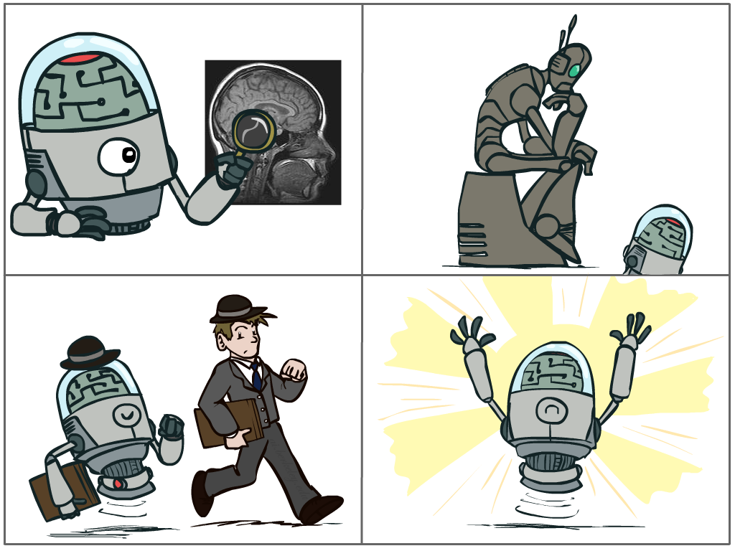
What is AI?
The science of making machines that:
Think like people
Think rationally
Act like people
Act rationally
Notes:
Top left: Think like people --- cognitive science, neuroscience
Bottom left: act like people --- actually very early definition, dating back to Alan Turing --- Turing test; problem to do really well you start focusing on things like don’t answer too quickly what the square root of 1412 is, don’t spell too well, and make sure you have a favorite movie etc. So it wasn’t really leading us to build intelligence
Think rationally – long tradition dating back to Aristotle --- but not a winner, because difficult to encode how to think, and in the end it’s not about how you think, it’s about how you end up acting

Slide 21
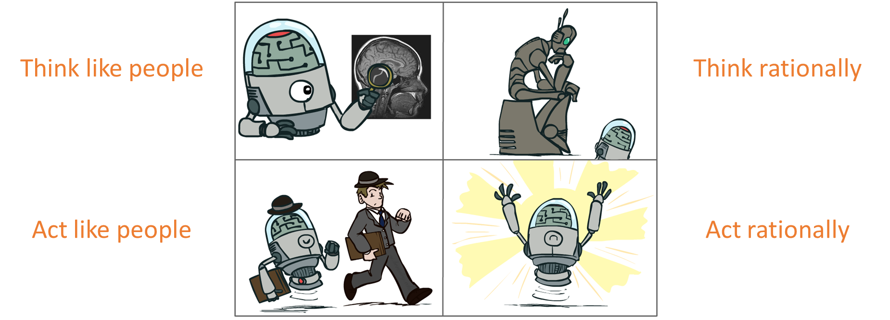
What is AI?
How can we test it?

Slide 22
The Turing Test
Ingredients:
Human Judge, unknown Entity
2 computer terminals in different room
Recipe:
Have human Judge sit at one computer
Judge converses with Entity via chat window for 5 minutes
Judge decides if Entity is human or computer

Slide 23
Which is which?
Left hand side
Right hand side
Judge: Hi what’s your name?
Entity: I don’t know
Judge: My name’s Jane. I live in London. Where do you live?
Entity: I live in London as well
Judge: Do you like living in London?
Entity: Yes, I like it because there are a lot of things to do, and it is the capital city of England
Judge: What’s my name?
Entity: sorry?
Judge: What’s my name?
Entity: Jane
Judge: And what’s your name?
Entity: I don’t know
Judge: What color is the carpet in your room
Entity: I like pink; what do you like?
Judge: I like pink. My name is John. What’s your name?
Entity: Red. Hello John. Its nice to meet such a fine person as yourself.
Judge: Red is my favorite color. What’s yours?
Entity: My favorite color is red.
Judge: You use American spelling. Are you in the USA?
Entity: But you are not even American. Just remember atheism is only a belief system. And it too can be forced on people who don’t agree.
Judge: How do you like your eggs – ever easy or sunny side up?
Entity: How I wonder if I like my eggs-over easy or sunny side up? This is so explainable. That list makes me feel unsure John.
Example taken from “Turing’s Imitation Game,” by Warwick and Shah (2016)

Slide 24
How to do well in the Turing Test?
Chatting “like a human” involves:
Generating coherent language
Responding appropriately to unexpected inputs
…

Slide 25
What is not shown?
The Turing Test does not show
Understanding or thinking
Ability to learn
Interaction with an unconstrained world
Processing sensory input
Having knowledge
Much of anything useful, really

Slide 26
Act rationally; rational decisions
We’ll use the term rational in a very specific, technical way:
Rational: maximally achieving pre-defined goals
Rationality only concerns what decisions are made (not the thought process behind them)
Goals are expressed in terms of the utility of outcomes
Being rational means maximizing your expected utility
Rational behavior = doing the right thing, does not necessarily involve thinking

Slide 27
Act rationally; rational decisions
We’ll use the term rational in a very specific, technical way:
Rational: maximally achieving pre-defined goals
Rationality only concerns what decisions are made (not the thought process behind them)
Goals are expressed in terms of the utility of outcomes
Being rational means maximizing your expected utility
Rational behavior = doing the right thing, does not necessarily involve thinking
Example:
Goal: do well in the CSE 3521 course
Utility: final grade
Being rational: review math materials and do the Linear Algebra quizzes!

Slide 28
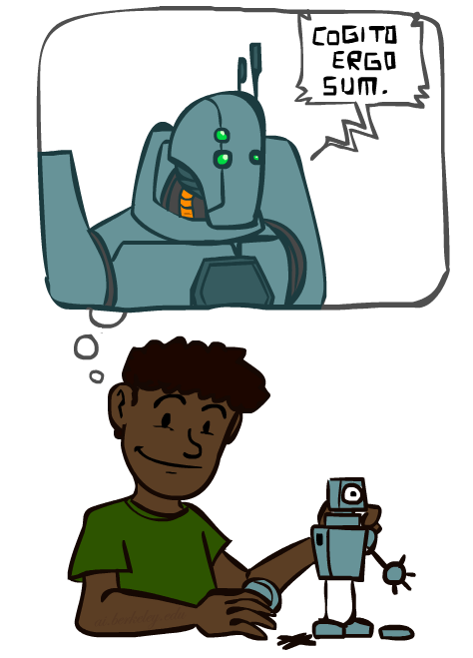
A (** Short **) history of AI
1940-1950: Early days
1943: McCulloch & Pitts: Boolean circuit model of brain
1950: Turing's “Computing Machinery and Intelligence”
1950—70: Excitement: Look, Ma, no hands!
1950s: Early AI programs, including Samuel's checkers program, Newell & Simon's Logic Theorist, Gelernter's Geometry Engine
1956: Dartmouth meeting: the term “Artificial Intelligence” adopted
1965: Robinson's complete algorithm for logical reasoning
1970—90: Knowledge-based approaches
1969—79: Early development of knowledge-based systems
1980—88: Expert systems industry booms
1988—93: Expert systems industry busts: “AI Winter”
1990—: Statistical approaches
Resurgence of probability, focus on uncertainty
General increase in technical depth
Agents and learning systems… “AI Spring”?
2000—: Where are we now? (Machine learning, neural networks, deep learning, …)

Slide 29
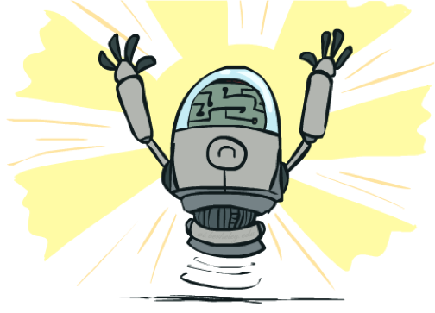
What can AI do?
Practice: Which of the following can be done at present?
Play a decent game of table tennis?
Play a decent game of Jeopardy/Go/Atari/Star raft?
Drive safely along a curving mountain road (w/o other traffic agents)?
Drive safely along High Street?
Buy a week's worth of groceries on the web?
Buy a week's worth of groceries at Worthington Farmers Market?
Discover and prove a new mathematical theorem?
Converse successfully with another person for an hour?
Perform a surgical operation?
Put away the dishes and fold the laundry?
Translate spoken Chinese into spoken English in real time?
Write an intentionally funny story?

Slide 30
Questions?

Slide 31
Important research areas related to AI
Speech processing
Natural language processing
Computer vision
Robotics
Logic
Game playing
Decision making
Autonomous driving
……

Slide 32
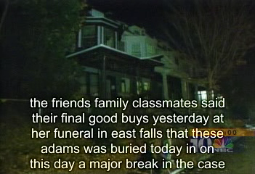
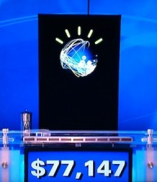
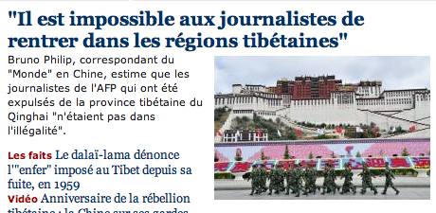
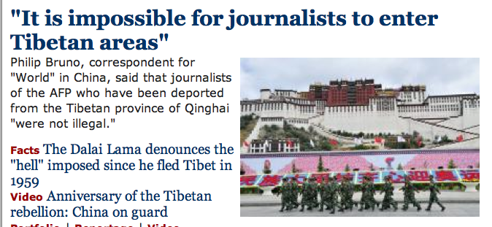
Speech processing & Natural language processing
Speech technologies (e.g., Siri, Alexa)
Automatic speech recognition (ASR)
Text-to-speech synthesis (TTS)
Dialog systems
Language processing technologies
Question answering
Machine translation
Web search
Text classification, spam filtering, etc…

Slide 33

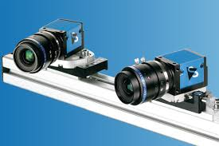
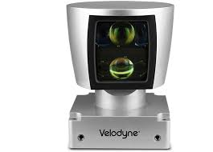
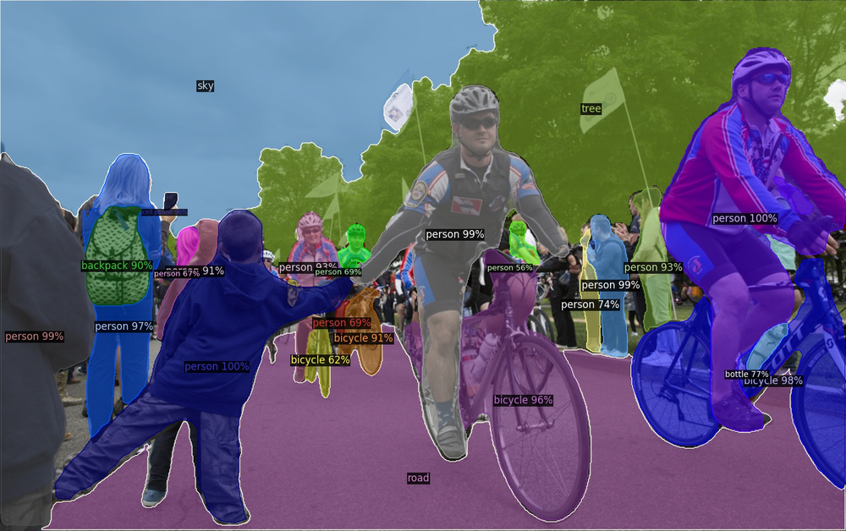
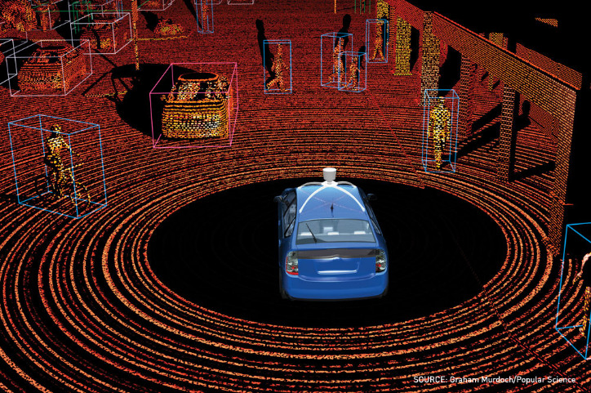
Computer vision
Object and face recognition
Scene segmentation
Image classification
[Source: Detectron2]
[Source: Graham Murdoch/Popular Science]

Slide 34
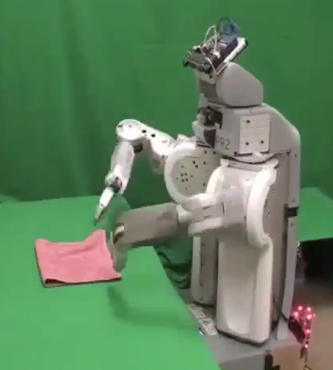
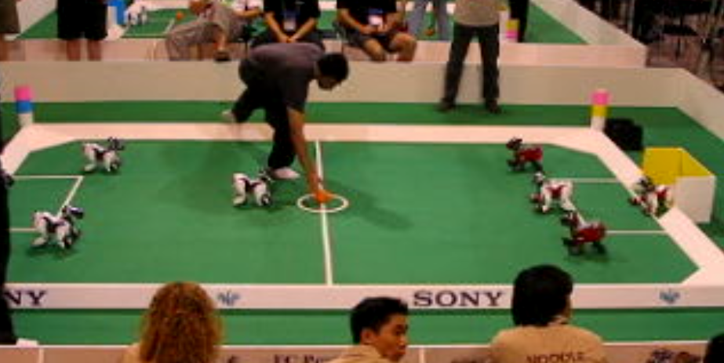
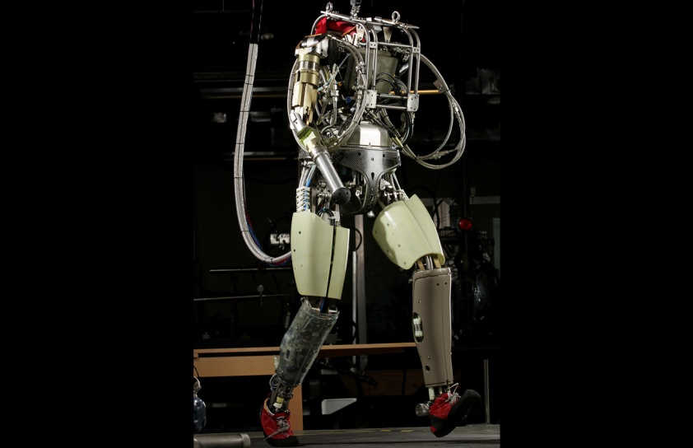
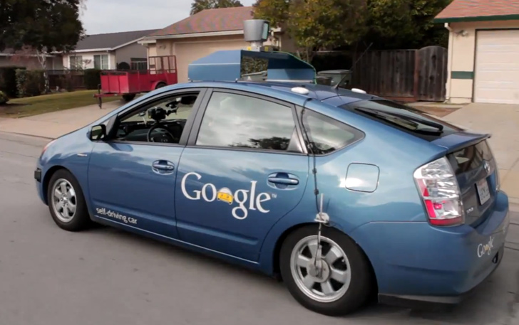
Robotics
Robotics:
Part mechanical engineering
Part AI
Reality much harder than simulations!
Technologies:
Vehicles
Rescue
Soccer!
Lots of automation …
In this class:
We ignore mechanical aspects
Methods for planning (and/or control)
[Images from UC Berkeley, Boston Dynamics, RoboCup, Google]

Slide 35
Logic
Logical systems:
Theorem provers
NASA fault diagnosis
Question answering
Methods:
Deduction systems
Constraint satisfaction
Satisfiability solvers (huge advances!)
[ Image from Bart Selman ]

Slide 36
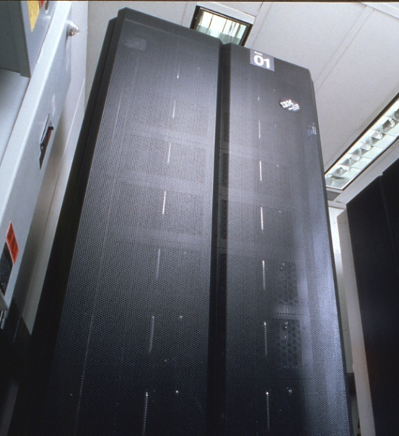
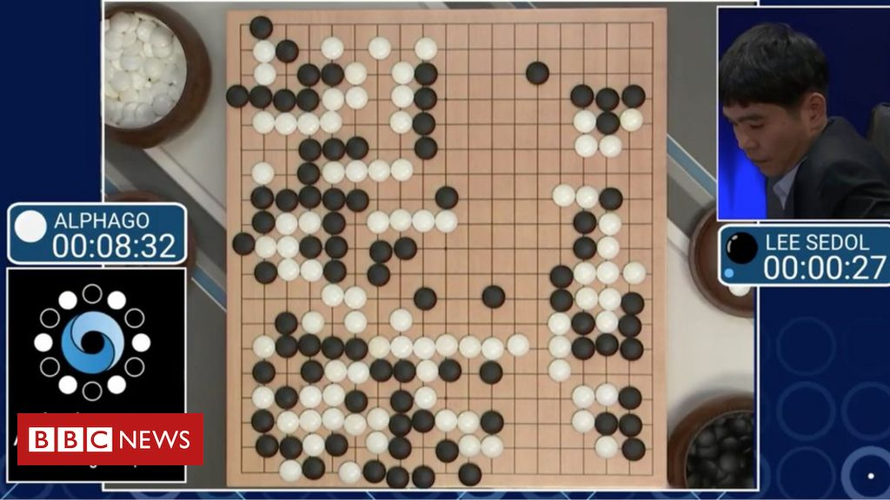
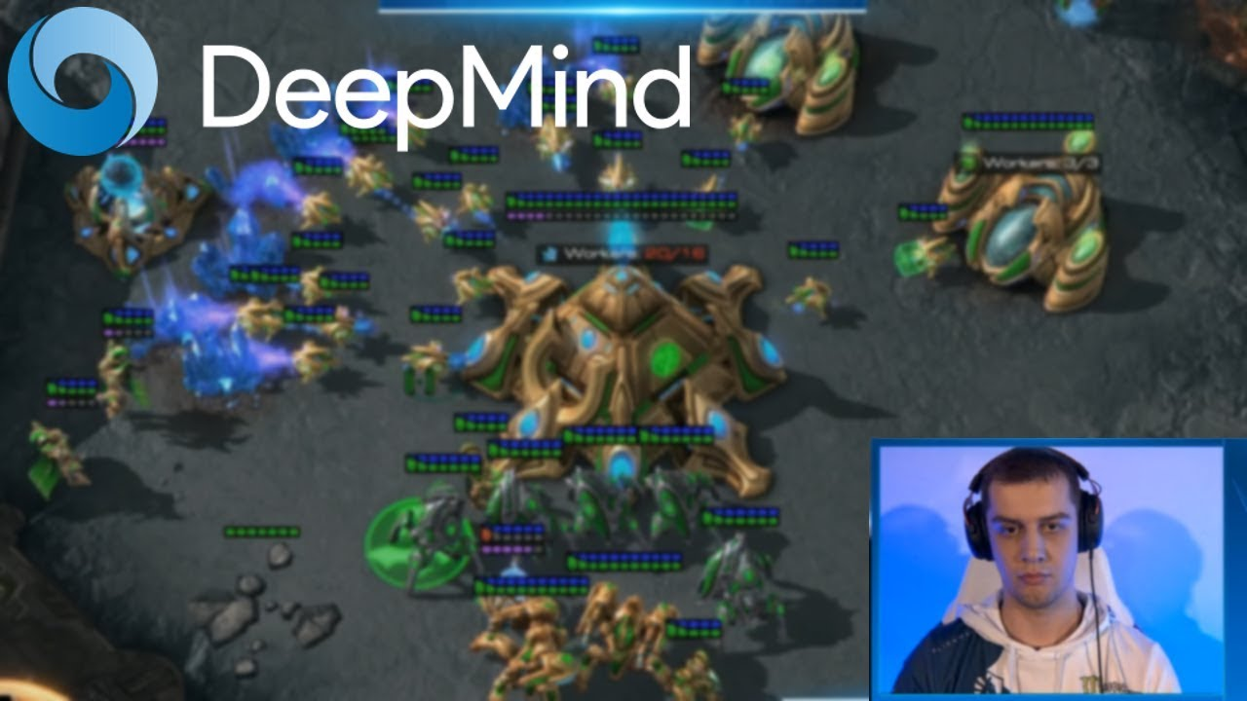
Game playing
Classic Moment: May, '97: Deep Blue vs. Kasparov
First match won against chess world champion
“Intelligent creative” play
200 million board positions per second
Humans understood 99.9 of Deep Blue's moves
Can do about the same now with a PC cluster
Open question:
How does human cognition deal with the
search space explosion of chess?
Or: how can humans compete with computers at all?
1996: Kasparov beats Deep Blue
“I could feel --- I could smell --- a new kind of intelligence across the table.”
1997: Deep Blue beats Kasparov
“Deep Blue hasn't proven anything.”
Huge game-playing advances recently, e.g., in Go, Atari, and Computer games!
[ Text from Bart Selman, image from IBM’s Deep Blue pages, Google DeepMind]
Notes:
Yeah, Kasparov comment probably says more about humans than about computers

Slide 37


Decision making
Applied AI involves many kinds of automation
Scheduling, e.g., airline routing, military
Route planning, e.g., Google maps
Medical diagnosis
Web search engines
Spam classifiers
Automated help desks
Fraud detection
Product recommendations
… Lots more!
Notes:
All applications can be thought of as decision making or useful sub-components of decision making

Slide 38
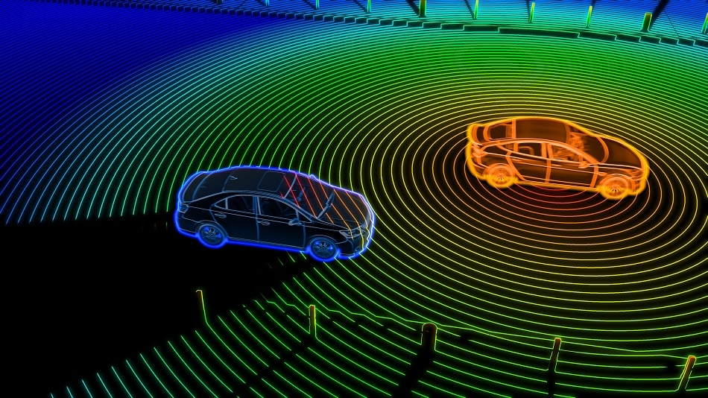
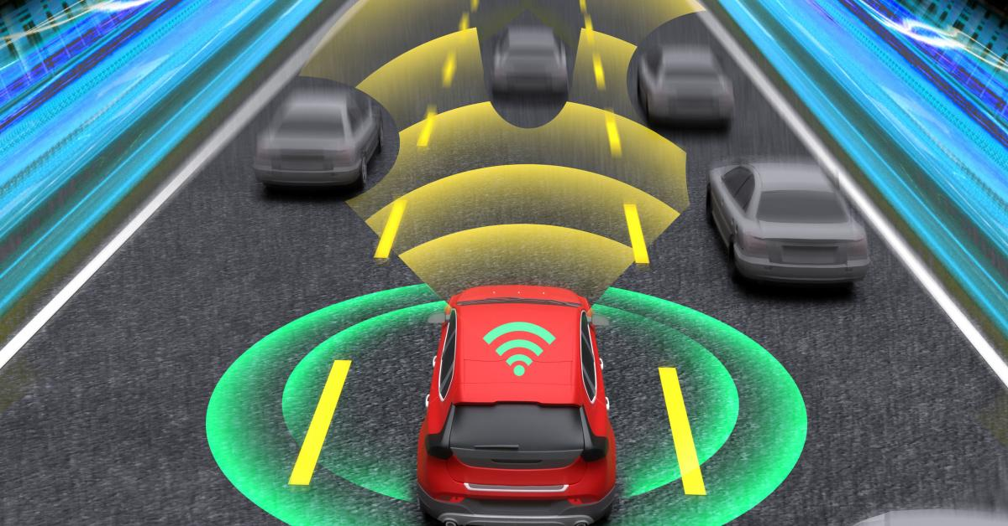
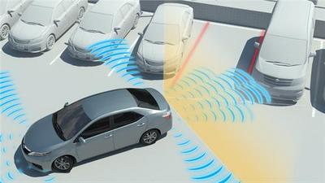
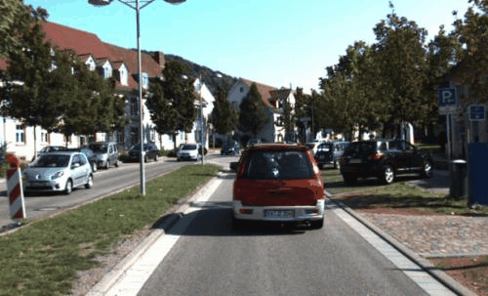

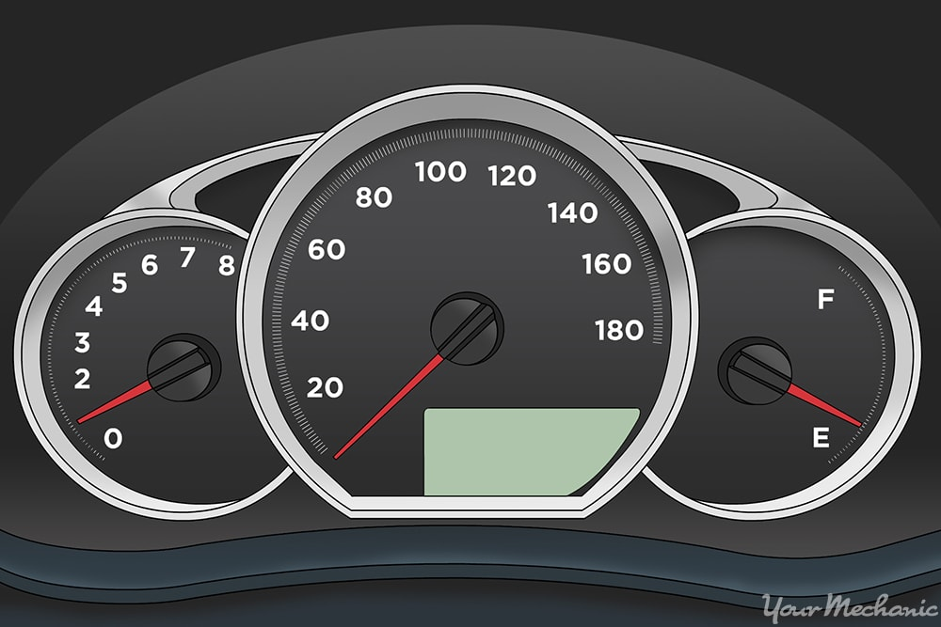
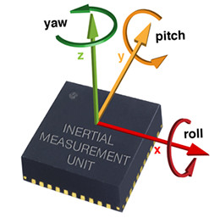


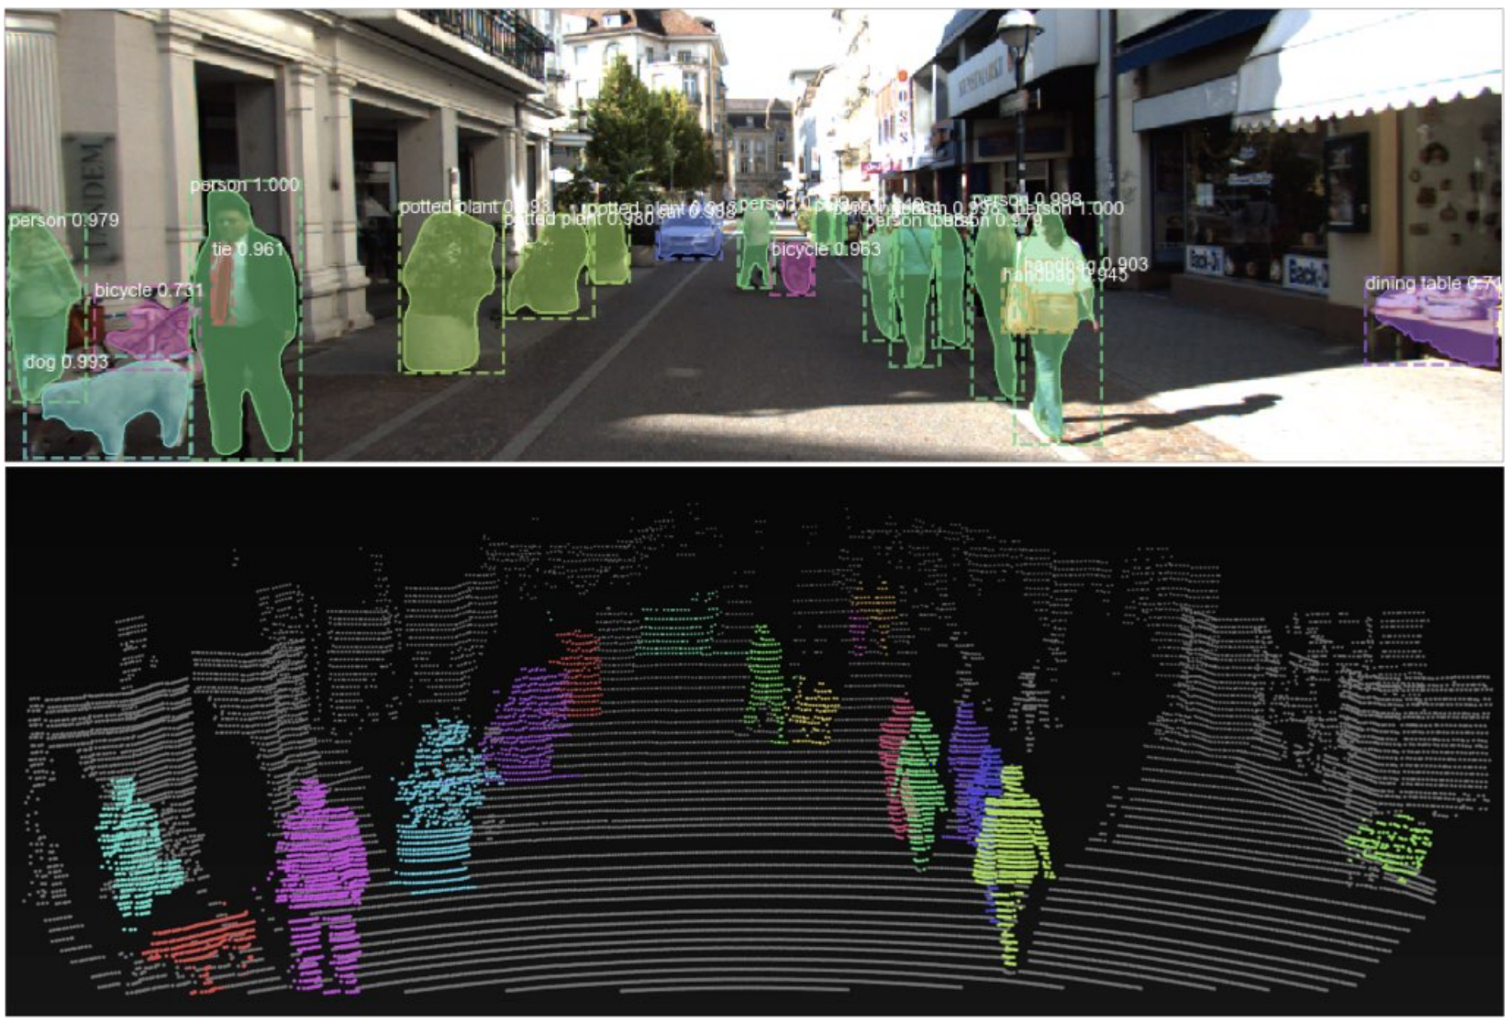
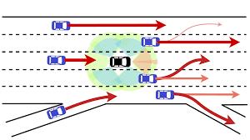



Autonomous driving
LiDAR
Radar
Sonar
Camera
Others
Perception
Prediction & Planning
Action & decision
Notes:
A self-driving car perceive the world/environment via a variety of sensors, predict how other traffic agents will move and plan how to move, and finally perform actions on the steering, accelerator, etc.

Slide 39
This course
Search: How do I (efficiently) find a solution?
Logic and Knowledge: How do I determine what is/isn’t known?
Decision Policies: How do I choose the best next action?
Probability: How do I handle dependency and non-determinism?
Machine Learning: How do I learn from data and/or experience?
Philosophy and Ethics: How do I determine what is intelligent? And how do I know that what I’m doing is good?

Slide 40
This course (topics)
AI agent design
Search
Symbolic AI & Logical Inference
Data-to-features and dimensionality reduction
General parameter estimation techniques
Probability basics and probabilistic methods
Unsupervised learning
Supervised learning
Neural networks and deep learning
Reinforcement learning basics
Ethics and philosophy of AI

Slide 41
CSE 3521: Agent Design
[Many slides are adapted from the UC Berkeley. CS188 Intro to AI at UC Berkeley and previous CSE 3521 course at OSU.]

Slide 42
What is AI?
The science of making machines that:
Think like people
Think rationally
Act like people
Act rationally

Slide 43
The Fundamental question for this lecture
(and really this whole AI field!):
How do you turn a real-world
problem into an AI solution?
Notes:
Before a solution, you need to formulate the goal well

Slide 44
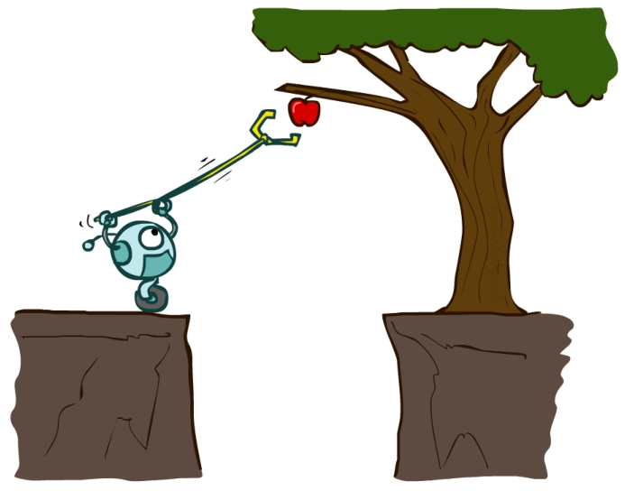
AI – agents and environments
Much (though not all) of AI is concerned with agents operating in environments.
Environment – the problem setting
Agent – an entity that perceives its environment through sensors and acts upon that environment through effectors (actuators)

Slide 45

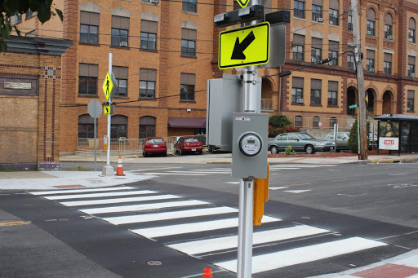
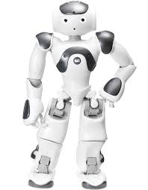
AI – agents and environments
Humans
Cross walks
perception
Sensors: eyes, ears, etc.
Effectors: hands, legs, mouth, etc.
Environment
Agent
action
Sensors: cameras, 3D sensors, etc.
Effectors: various motors, robot arms, etc.
Robots

Slide 46
AI – agents and environments
Humans
Cross walks
perception
Sensors: eyes, ears, etc.
Effectors: hands, legs, mouth, etc.
Environment
Agent
action
Sensors: cameras, 3D sensors, etc.
Effectors: various motors, robot arms, etc.
Percept: Agent’s perceptual inputs at any given instant
Percept sequence: Complete history of everything agent has perceived
Agent’s choice of action (e.g., walk forward for a step, push the bottom) can depend on entire percept sequence
Robots

Slide 47
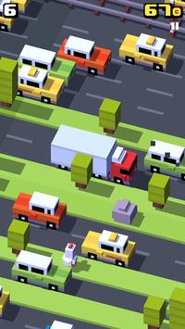
Fleshing it out
Performance – measuring the agent’s success
Environment – what populates the problem’s world?
Actuators – what can the agent act with?
Sensors – how can the agent perceive the world?

Slide 48
Peas in autonomous taxi
Performance – Safe, fast, legal, and comfortable trip; maximize profits
Environment – Roads, other traffic agents (e.g., pedestrians), customers
Actuators – Steering, accelerator, brake, signals, horn, display
Sensors – Cameras, sonar, LiDAR, radar, speedometer, GPS, odometer, accelerometer, engine sensors, microphone/keyboard

Slide 49
Peas: Other examples
Agent Type | Performance measure | Environment | Actuators | Sensors
Medical diagnosis system | Healthy patient, minimize costs/lawsuits | Patient, hospital, staff | Display questions, tests, diagnoses, treatments, referrals | Keyboard entry of symptoms, findings, patient’s answers
Satellite image analysis system | Correct image classification | Downlink from orbiting satellite | Display classification of scene | Color pixel arrays (cameras)
Part-picking robot | Percentage of parts in correct bins | Conveyor belt with parts, bins | Jointed arm and hand | Camera, joint angle sensors
Refinery controller | Maximize purity, yield, safety | Refinery, operators | Valves, pumps, heaters, displays | Temperature, pressure, chemical sensors
Interactive English tutor | Maximize student’s score on test | Set of students, testing agency | Display exercises, suggestions, corrections | Keyboard entry

Slide 50
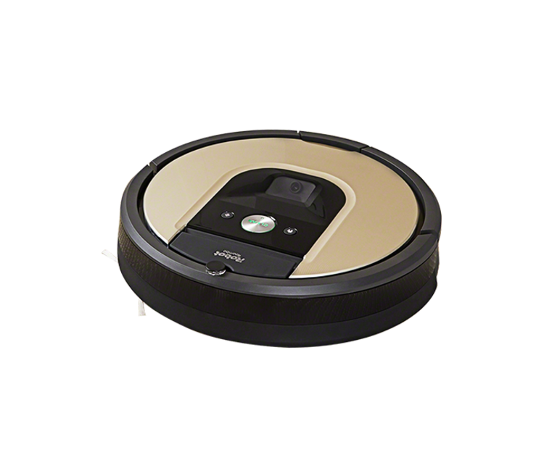
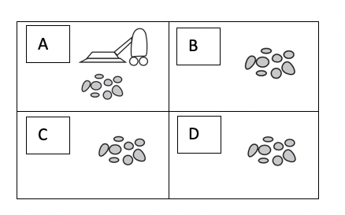
In class exercise
Give a ‘PEAS’ description of the task environment for the following vacuum-cleaner world with four locations.

Slide 51
In class exercise
Give a ‘PEAS’ description of the task environment for the following vacuum-cleaner world with four locations.
Performance –
Environment –
Actuators –
Sensors –

Slide 52
In class exercise
Give a ‘PEAS’ description of the task environment for the following vacuum-cleaner world with four locations.
Performance – cleanness, efficiency, distance traveled
Environment – room with 4 squares
Actuators – wheels, brushes, vacuum extractor
Sensors – dirt detection

Slide 53
Summary
Introduction to AI
Act like humans vs. act rationally
AI applications
Agent design (part 1)
Agents and environments
PEAS: performances, environments, actuators, sensors.

